Slide 1





Cyber Sentinal
CU_CP_Team ID - 12836
Alampally Prasanna Laxmi
Buddiga Susmita
Bachala Ramya
Under the mentorship of,
Mentor Name: Kurumurthy Pasupula
Notes:
Slide Duration: 5 min
Objective: To get an insight about Design Thinking
Procedure:
Explanation:
Introduce the topic "Design Thinking"
Design thinking is a creative approach to problem-solving that puts people at the center.
It starts with understanding the needs of those who will use what you're designing.
Then, it involves brainstorming ideas, prototyping solutions, and testing them to see what works best.
It's about being open-minded, collaborative, and willing to try new things to come up with innovative solutions that really fit people's needs.
Learning outcome: Students will be introduced to the topic Design Thinking.
1

Slide 2




Creating A Future-ready Workforce
Project Objectives
Problem Statement
Project Overview – Introduction
End Users
Wow Factor in Project
Modelling/Block Diagram/Flow of Project
Result/outcomes
Conclusion
Future Perspective
Source
https://www.freepik.com/
Notes:
Slide duration: 5 min
Objective: To know the content of the lesson.
Procedure:
Tell students what they are going to learn today.
Discuss each topics given in the slide.
Learning Outcome: Students will get to know the content of today's lesson.
2

Slide 3
Creating A Future-ready Workforce
Problem Statement
Organizations face increasing cyber threats that traditional security systems fail to detect in real-time. Manual threat analysis is slow, error‑prone, and cannot scale with growing network traffic. There's a critical need for an automated, intelligent system that can detect anomalies, classify threats, and suggest immediate responses. Such a system also helps reduce human workload, improves accuracy, and strengthens overall resilience against fast‑moving attacks.
Notes:
Total duration: 5mins
Learning Objective: In this slide, the trainer will explain the students what they will learn and be able to apply in the real life situations.
Procedure: Discuss the above as the outcome of the session
Learning outcome: Students will understand the learning outcome in this slide.
3

Slide 4
Creating A Future-ready Workforce
Project overview - Introduction
CyberSentinel is an AI-powered Security Operations Center (SOC) dashboard that combines:
Machine Learning: Uses Isolation Forest algorithm to detect network anomalies
Agentic AI: Intelligent rule-based decision making for threat classification
Real-time Monitoring: Live attack feed visualization
Automated Response: Recommends actions like "Block IP" or "Isolate System"
The system analyzes network logs including:
Packet count
Failed login attempts
Session duration
Notes:
Total duration: 5mins
Learning Objective: In this slide, the trainer will explain the students what they will learn and be able to apply in the real life situations.
Procedure: Discuss the above as the outcome of the session
Learning outcome: Students will understand the learning outcome in this slide.
4

Slide 5
Creating A Future-ready Workforce
End User
Security Analysts - Monitor threats and investigate alerts
SOC Teams - Get automated threat intelligence
IT Administrators - Receive actionable response recommendations
Small to Medium Businesses - Affordable security monitoring solution
Educational Institutions - Learn about AI in cybersecurity
Notes:
Total duration: 5mins
Learning Objective: In this slide, the trainer will explain the students what they will learn and be able to apply in the real life situations.
Procedure: Discuss the above as the outcome of the session
Learning outcome: Students will understand the learning outcome in this slide.
5

Slide 6
Creating A Future-ready Workforce
Wow factor
1.Dual-AI Architecture
Machine Learning (Isolation Forest) + Agentic AI (Rule-based Reasoning) in one pipeline. ML detects unknown anomalies while Agentic AI provides intelligent, context-aware decisions.
2. Real-time Attack Simulation
Live attack feed auto-refreshes every 5 seconds simulating DDoS, Brute Force, Port Scans, and Malware Traffic - creates immersive SOC experience without real attack infrastructure.
3. Multi-threat Intelligence
Identifies 4+ specific attack types beyond binary classification - provides attack-specific context for faster, more accurate incident response.
4. Zero-configuration Deployment
Works out-of-the-box with automatic directory creation, no database setup, no training data required - deploy within minutes with professional-grade SOC dashboard.
Notes:
Total duration: 5mins
Learning Objective: In this slide, the trainer will explain the students what they will learn and be able to apply in the real life situations.
Procedure: Discuss the above as the outcome of the session
Learning outcome: Students will understand the learning outcome in this slide.
6

Slide 7
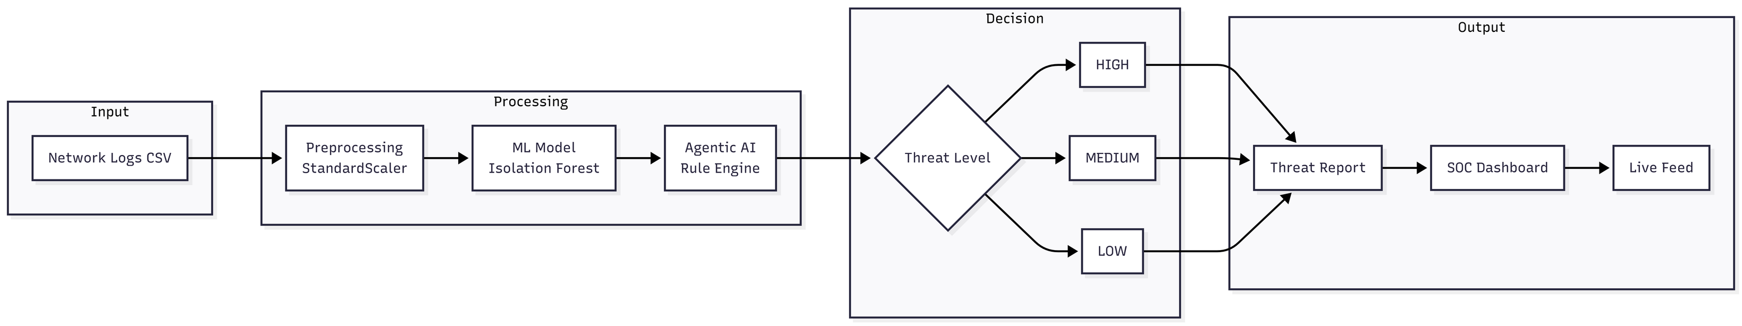
Creating A Future-ready Workforce
Modelling
Notes:
Total duration: 5mins
Learning Objective: In this slide, the trainer will explain the students what they will learn and be able to apply in the real life situations.
Procedure: Discuss the above as the outcome of the session
Learning outcome: Students will understand the learning outcome in this slide.
7

Slide 8
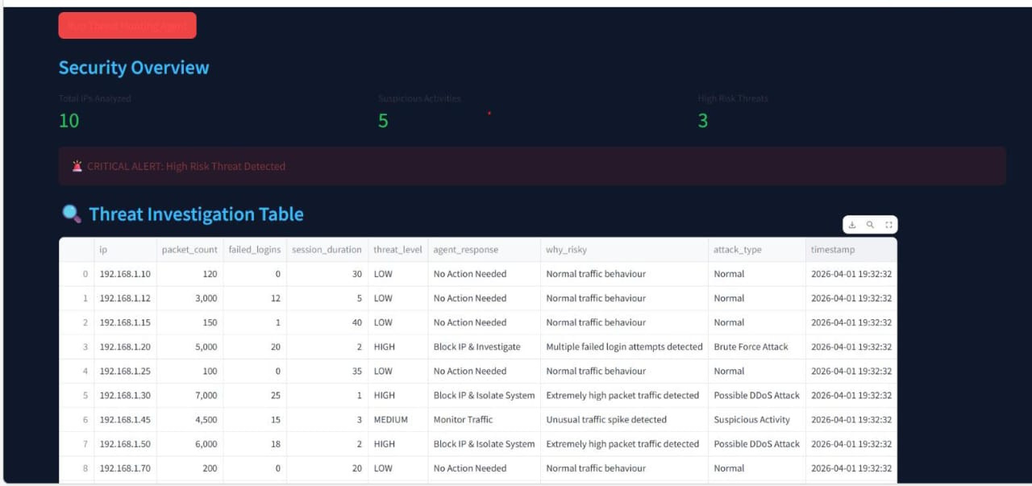
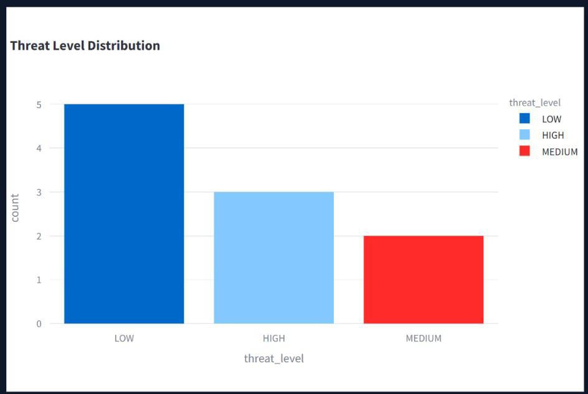
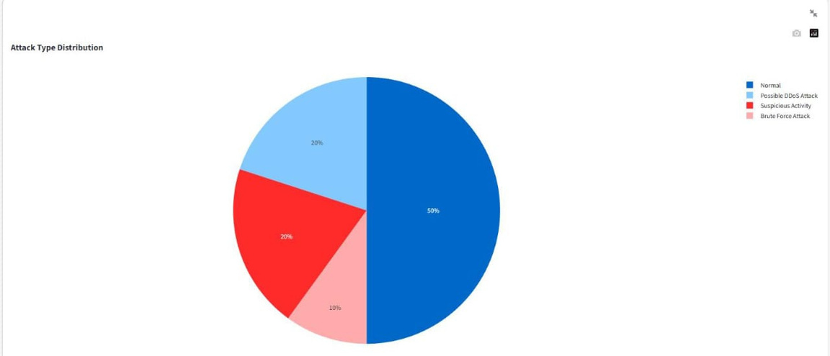
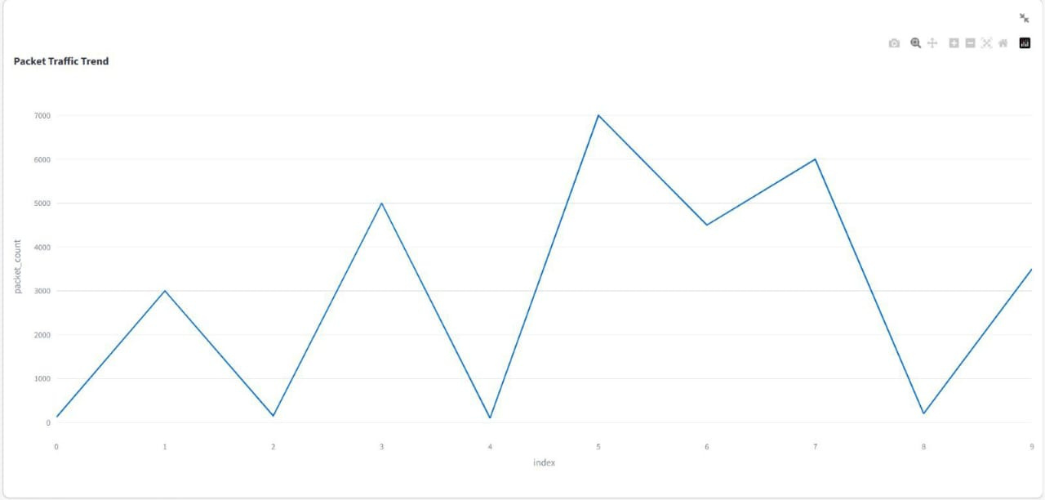
Creating A Future-ready Workforce
Result / Outcomes
Notes:
Total duration: 5mins
Learning Objective: In this slide, the trainer will explain the students what they will learn and be able to apply in the real life situations.
Procedure: Discuss the above as the outcome of the session
Learning outcome: Students will understand the learning outcome in this slide.
8

Slide 9

Creating A Future-ready Workforce
Conclusion
CyberSentinel successfully demonstrates effective anomaly detection using the Isolation Forest machine learning algorithm, enabling the identification of unusual patterns in network activity. The system provides intelligent threat response through Agentic AI decision-making, ensuring timely and automated mitigation of potential security risks. It features a user-friendly SOC dashboard for continuous security monitoring and a scalable architecture capable of processing multiple network logs efficiently. Additionally, explainable outputs help analysts understand the reasoning behind detected threats, bridging the gap between ML-based detection and actionable security responses, making CyberSentinel a valuable tool for modern SOC operations.
Source
https://www.freepik.com/
Notes:
Slide duration: 5 min
Objective: To get clarity about the lesson is well received among students.
Procedure:
Ask: What did you learn from the lesson?
What is your takeaways from the lesson?
How this lesson is going to help you in your personal and professional life.
How are you going to implement this lesson?
9

Slide 10
Creating A Future-ready Workforce
Future Perspective
1. Real-time Packet Capture Integration
Integrate with live network traffic (pcap files) and packet sniffing tools like Wireshark to analyze real-time data streams instead of static CSV files.
2. Automated Threat Mitigation
Connect with firewalls, routers, and IDS/IPS systems to automatically block malicious IPs and isolate compromised systems without manual intervention.
3. Deep Learning Models
Implement advanced neural networks like LSTM for time-series analysis and CNN for pattern recognition to detect sophisticated zero-day attacks.
4. Mobile SOC Application
Develop a mobile app for iOS and Android allowing security teams to monitor threats, receive push notifications, and respond to incidents from anywhere.
Notes:
Total duration: 5mins
Learning Objective: In this slide, the trainer will explain the students what they will learn and be able to apply in the real life situations.
Procedure: Discuss the above as the outcome of the session
Learning outcome: Students will understand the learning outcome in this slide.
10

Slide 11
Creating A Future-ready Workforce
Thank You
Notes:
Time: 25 to 30 Sec
11

